Slide 1
Group 5 Presentation
Amazon Consumer survey
Bridget, Eileen, Kyle, and Maia

Slide 2
Introduction
Our database examines the behaviors and attitudes of Amazon customers. We proposed our questions based on what we believe the average seller may be thinking when they list items for purchase on Amazon. Our data allows us to examine who and how people purchase goods on one of the largest e-commerce platforms.
Notes:
Eileen

Slide 3
How do different age groups’ purchasing frequency on Amazon compare?

Slide 4
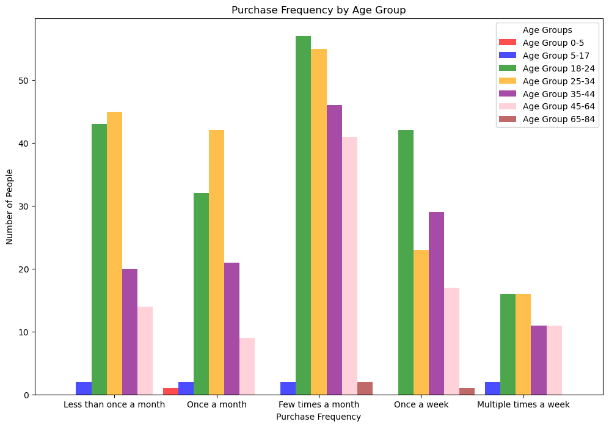

Slide 5
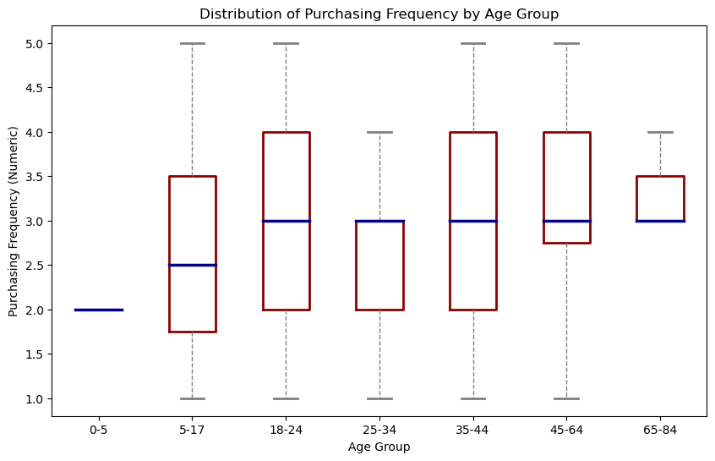

Slide 6
Age Group Purchasing Frequency Conclusions
Majority of people in the sample purchase something on Amazon once a month
18-34 year olds purchase most frequently on Amazon
The purchasing behaviors of 18-24 year olds and 35-44 year olds vary the most

Slide 7
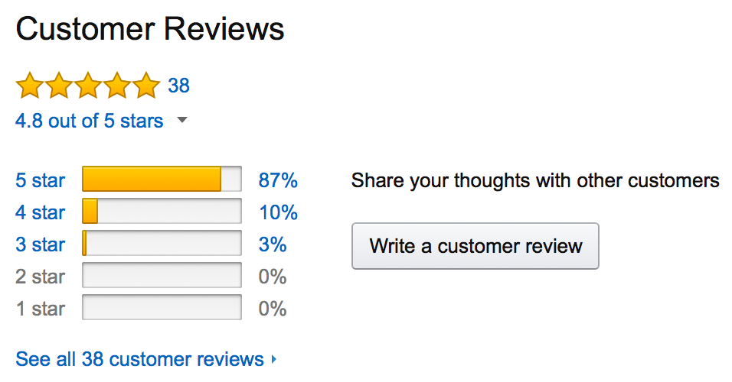
Which customers leave reviews?

Slide 8
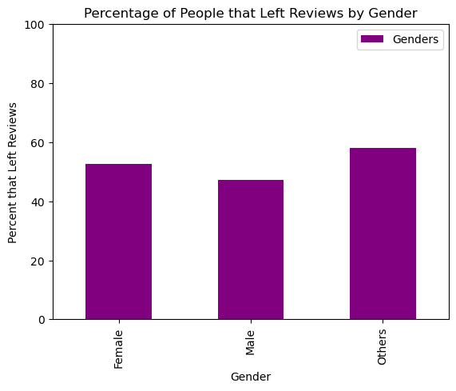
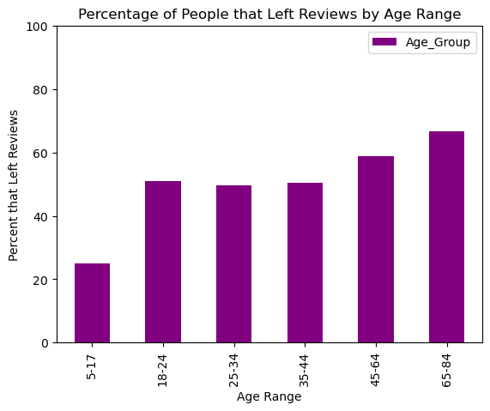

Slide 9
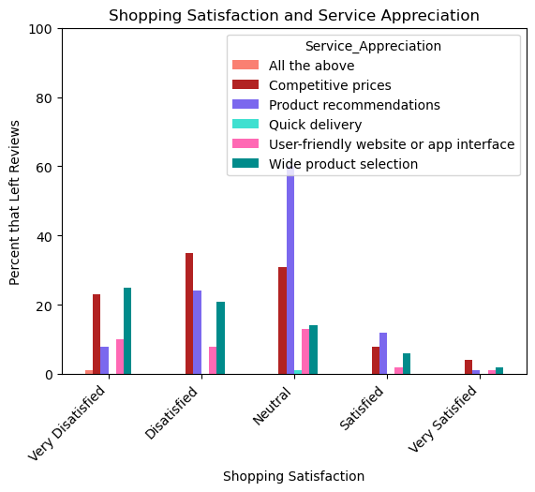

Slide 10
Amazon Reviewer Characteristics
People leave reviews at similar rates regardless of gender
The rate of reviews is nearly identical for adults under 45
Older groups leave the most reviews
Satisfied customers leave less reviews than neutral or unsatisfied customers

Slide 11
Cart Abandonment

Slide 12
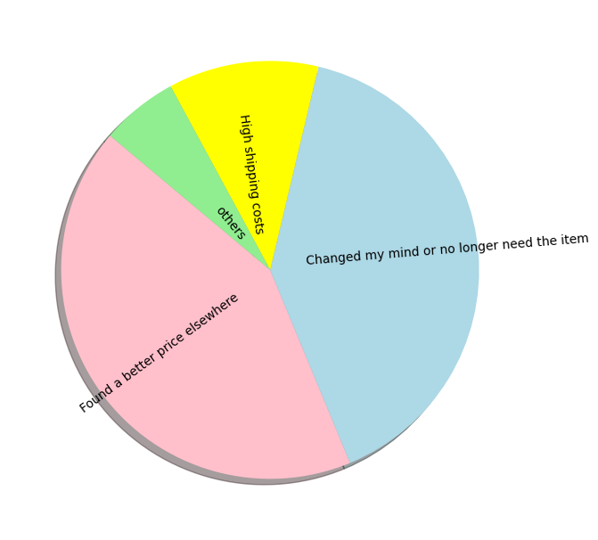
Cart Abandonment - Reasons

Slide 13
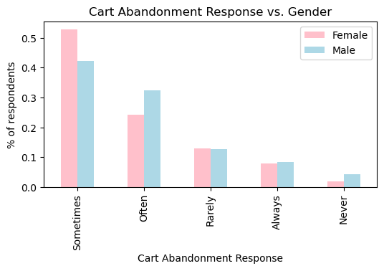
Cart Abandonment Response vs. Gender

Slide 14
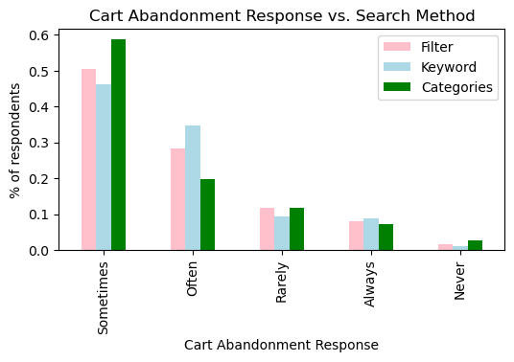
Cart Abandonment Response vs. Search Method

Slide 15
Cart abandonment conclusions
Biggest reasons are people changing their mind and finding a better price elsewhere
A higher % of men abandon carts “Often” or “Never vs. “Sometimes”
The % of people who searched by categories stated that they abandon carts “sometimes” is approximately 10% more than the percentages for the other search types, but people who search by categories are less likely to select “Never”

Slide 17
Browsing vs. Buying:
How do consumers compare when it comes to browsing through Amazon compared to purchasing?

Slide 18
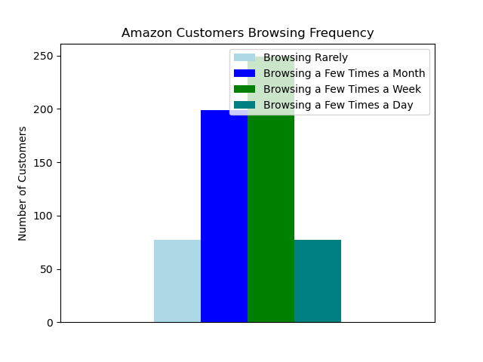
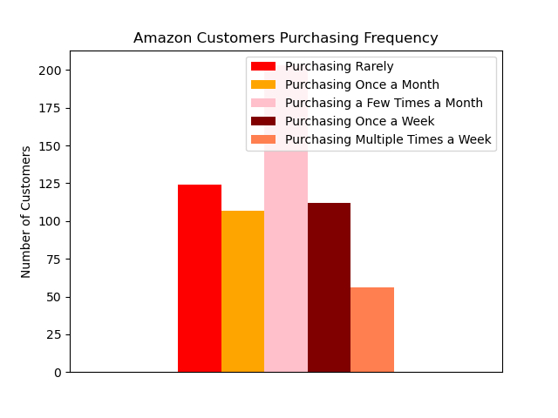
Browsing Frequency vs. Purchasing Frequency
Notes:
Key takeaways
Browsing: most customers brows a few times a week or a few times a month. Few customers fall on the extreme ends of browsing: either rarely or multiple times a day.
Purchasing: Purchasing behaviors are a little more evenly distributed among customers, but the most frequent purchasing behavior is a few times a month. Similar to browsing, most people do not purchase multiple times a week. However, in contrast to browsing, some do purchase rarely and/or once a month from Amazon.

Slide 19
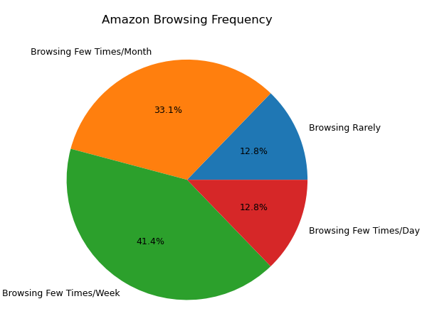
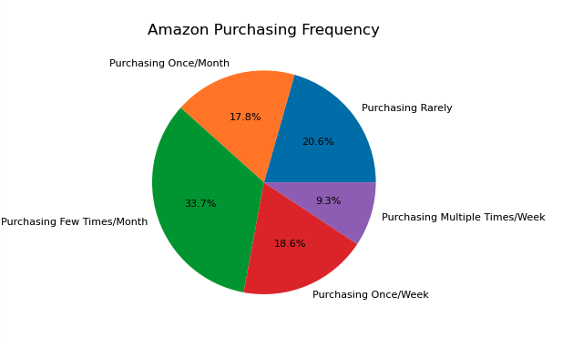
Browsing Frequency vs. Purchasing Frequency
Notes:
These pie charts show the percentages of customers and their respective behaviors. For browsing, over 40% of customers browse a few times a week. This is clearly the dominant customer behavior. When combining browsing a few times a week with browsing a few times a day, nearly 65% of customers browse weekly to some extent.
For buying, the dominant behavior is to purchase a few times a month with 33.7% of customers reporting this behavior. Interestingly, the next most common behavior is to purchase once a week. A similar percentage of consumers purchase once a week as they do once a month.
The dominant behaviors show that in general, customers browse more frequently than they purchase. This makes sense, because most people are limited financially. This may restrict their wish list of “nice to haves” to their “must haves.” Additionally, people may browse several times when searching for a single product to find the best reviewed product at the best price.
So what: as a seller, it may important to target the most frequent browsers so that when they go to purchase, your product is top of mind and more likely to be added to their cart.

Slide 20
Browsing vs. Buying Final Conclusions
41.4% of customers self-report browsing a few times a week
33.7% of customers self-report purchasing a few times a month
Customers browse much more frequently than they buy
Notes:
More info needed to answer they “why”
Potential reasons:
Financial limitations
Shopping around for a single product
Purchasing more than one item in a single order

Slide 21
Final Conclusions
18-34 year olds purchase most frequently on Amazon
People abandon their carts mainly due to changing their mind or finding a better price, rather then due to shipping costs.
Amazon reviewers are a diverse group but older groups leave more reviews.
Amazon customers browse the storefront much more frequently than they buy.
Frequent browsing (weekly) a dominant characteristic.
Notes:
Maia

Slide 22
Discussion and Limitations
Qualitative data
Voluntary → no-response not accounted for
Subjective → response bias likely
Clicking through
Age is skewed young
Gender skewed female
Small sample size
Outstanding questions about the data
Example: what does “purchase” mean?
Notes:
Bridget doing this
About 600 respondents, subjective, qualitative data
Most respondents were women aged 25-34
Relatively small sample size compared to the millions that use Amazon

Slide 23
Future Research
Objective data
Quantitative measures linked to a single customer ID
Temporal data to show behavior over time
A more heterogeneous sample that is representative of U.S. population
Age consideration
Larger sample size (thousands to tens of thousands)
Notes:
Kyle

Slide 24
Questions?

Slide 25
Sources
Menon, S. (2023). Amazon consumer Behaviour Dataset [Dataset]. Kaggle. https://www.kaggle.com/datasets/swathiunnikrishnan/amazon-consumer-behaviour-dataset/data.

